Slide 1
Welcome to UWI SAIIL, this Presentation demonstrates how to Register for the Programme using our electronic registration platform, VENTURESAPP

Slide 2
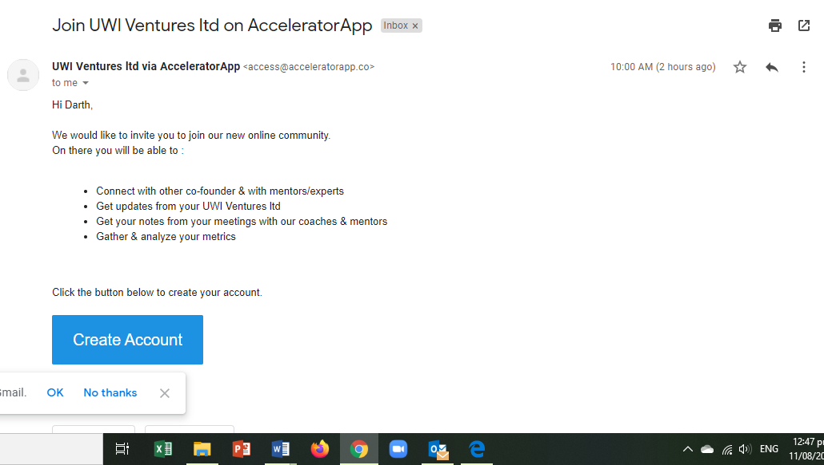
1. RECEIVE YOUR ACCESS KEY
Hi Jane

Slide 3
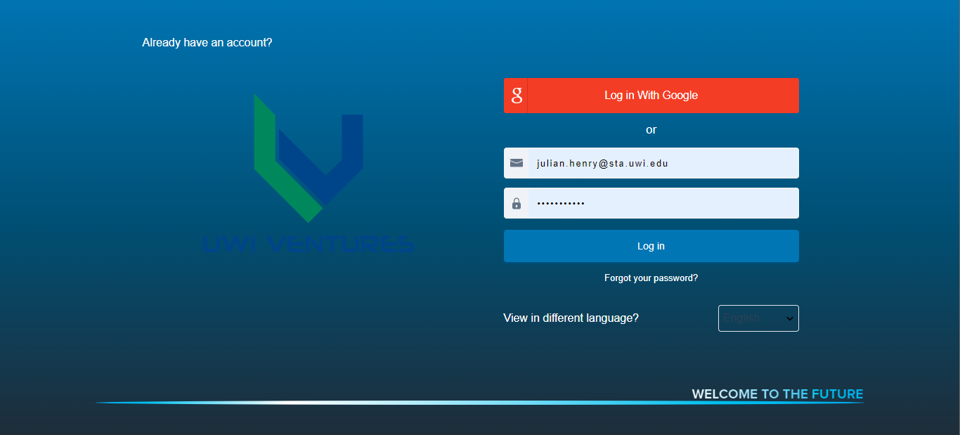
2. REGISTER YOUR ACCOUNT
Jane.Doe@gmail.com
You can return to this log-in Page at any time using this url:
connect.uwiventuresltd.com
Please don’t forget your password once you create it. If you do however, you can always click ‘forgot password’ to create a new one. Also, you can return to the Login Page any time by using connect.uwivenvturesltd.com/login from your device.

Slide 4
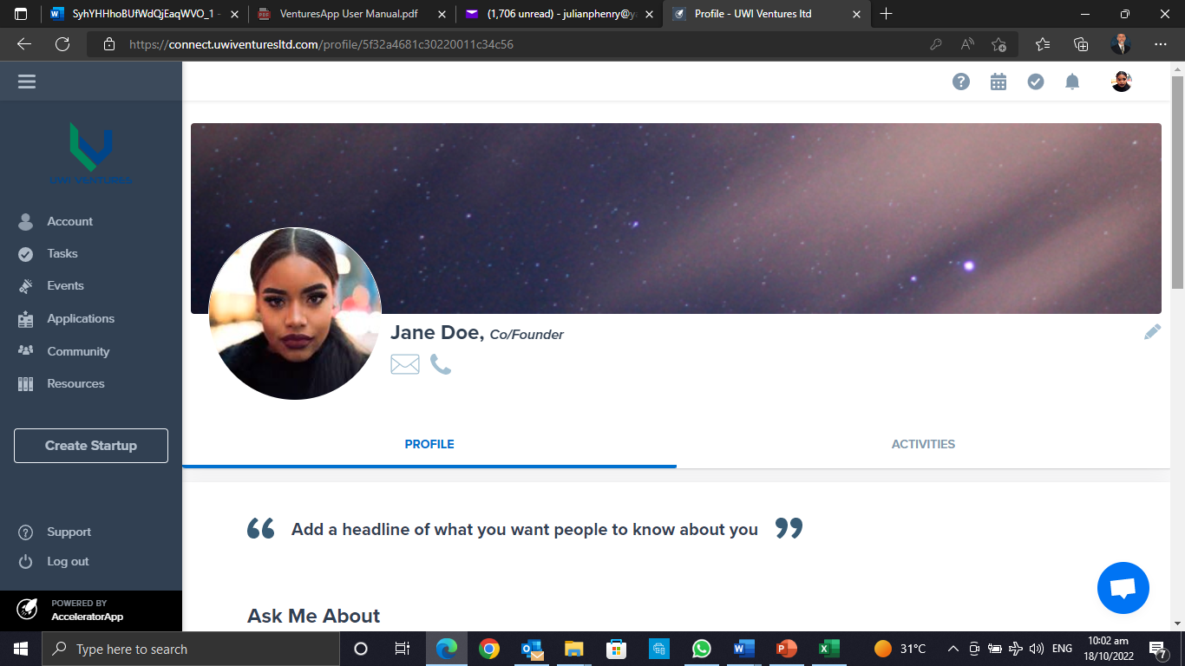
3. CUSTOMISE YOUR FILE / PROFILE (Profile Pic, social media address, etc.)

Slide 5
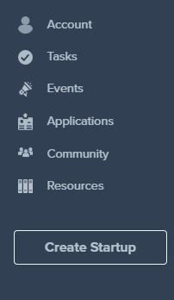
4. Once your Profile is Created, Click “APPLICATIONS” from the Menu bar.

Slide 6
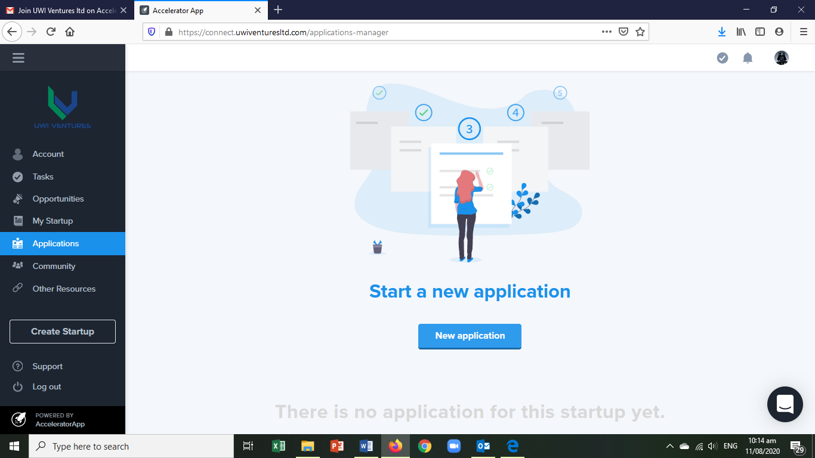
5. Then hit, “New Application”

Slide 7
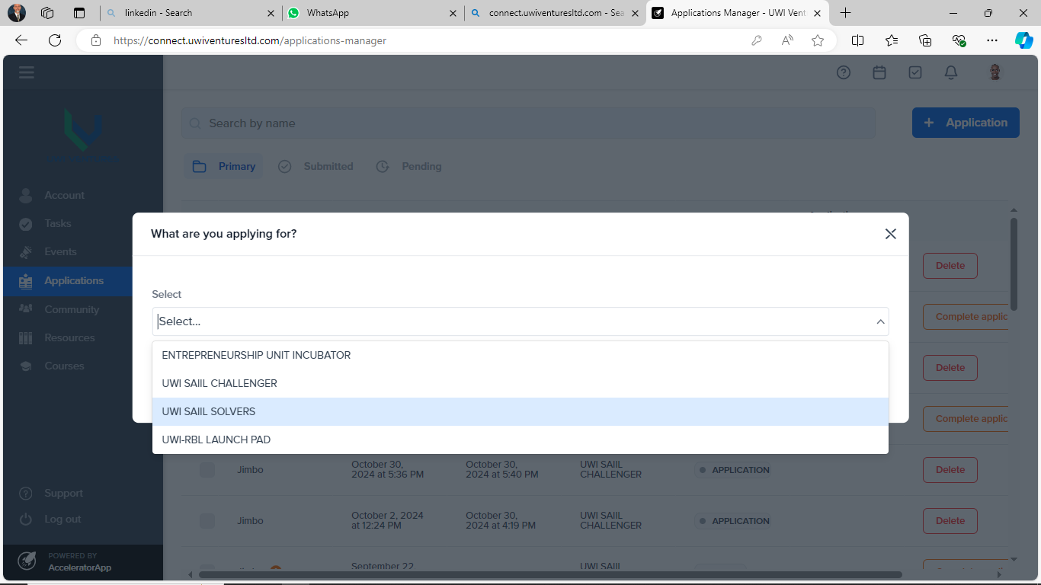
7. Select “Begin an Application” and choose “UWI SAIIL SOLVERS”

Slide 8
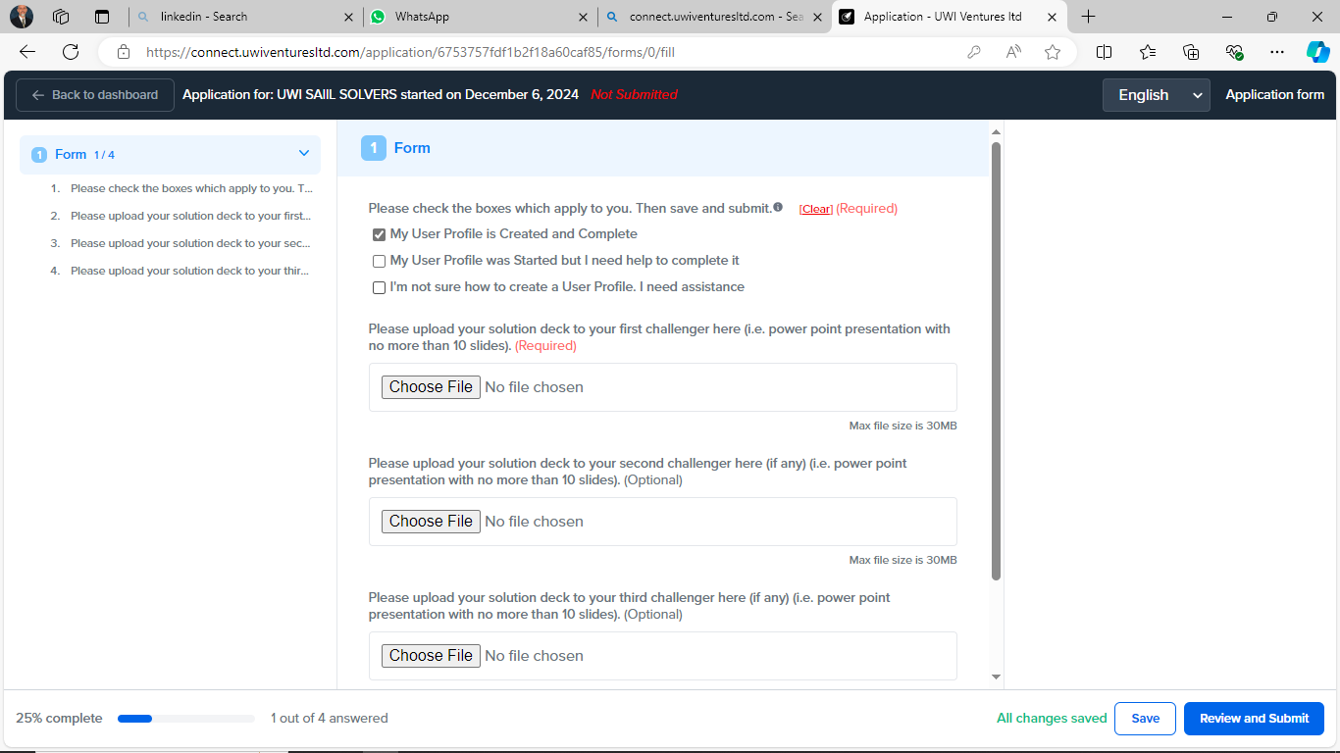
8. Go to FORM1 and complete the Required Questions

Slide 9
9.
Upload your Power Point Slide Deck (Not more than 10 Slides) which explains your Solution
Your First Slide Must Clearly Indicate Which Challenge you are addressing
You have the option to upload up to 3 Different Solutions (including solutions to different Challenges)

Slide 10
If you have any Questions email me at
Julian.henry@uwi.edu

